Slide 1



Team - De Marketing Keedas (T. A. Pai Management Institute, Manipal)
Devesh Sinha (21F521)
Kajal Gupta (21F126)
Mohit Kiradoo (21F331)

Slide 2





Market Research, Market SWOT & Pain Points
About the company, Features
& Revenue Model
Company SWOT, Competitors &
Competitor Analysis
Go-to Market Strategy & Financials
Appendix I
Appendix II
Insights from Primary Research
Insights from Secondary Research (PWC Report 2020)
On an average 72% people don’t track their monthly health expense separately but given a user-friendly and secured application they were interested to use it. (Exhibit 1 & 2)
73.3% people want regular reminders to track things like blood sugar blood pressure of themselves or their family members.(Exhibit 3)
Family members of 52% people are suffering from long term diseases and they want to track their regular consultation and updates.(Exhibit 4)
30% people do misplace their doctor’s prescription, reports and other important documents.(Exhibit 5)
Rising and distributed patient base.
Inadequate infrastructure and resources hindering access to even basic healthcare.(Exhibit 7)
Indians have the highest Out of Pocket Expenditure on healthcare.
Rising healthcare costs and limited budget allocation for healthcare further constrain the healthcare ecosystem in India.(Exhibit 6)
Behavioural factors such as change in lifestyle have resulted in newer types of diseases which require access to specialists who are few in number and cannot be reached through traditional means of healthcare delivery.
SWOT Analysis of the Market
Forecasted
to reach
₹ 138 bn
by 2024
Healthcare
Apps Market
₹ 27.01 bn
CAGR
31.61%
Fragmented
market
Strengths:
Cost Effective
Speedy access to medical data
Different revenue streams and monetization options
Rated as high for ease of use
Economic business model
Weakness:
Privacy concerns
Lack of awareness
consumers citing a lack of digital awareness among older patients.
Pain Points
User Issues
App Issues
Old School Approach
Documents getting lost
People forget about medicines
People want to maintain health budget but they don’t
Trust Issues
App Complexity
Advertisements
Manual Intervention
.
Opportunities:
Fragmented market
Digital healthcare platforms could be provided additional tax sops to promote entrepreneurship in this space
$6.8 billion of credit incentives to boost the country's healthcare infrastructure.
Technology integration like IoT, big data, AI, etc have the potential to cut out the healthcare costs.
Transforming healthcare with IoT to improve security, privacy, interoperability, and analytics for medical devices
Threats:
2/3 industry dominant players in the market
Possible change of legal regulations
Unreliable network, internet and electricity access
Cultural and trust concerns to adopt new technologies for sensitive data

Slide 3









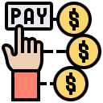



Market Research, Market SWOT & Pain Points
About the company, Features
& Revenue Model
Company SWOT, Competitors &
Competitor Analysis
Go-to Market Strategy & Financials
Appendix I
Appendix II
About The Company
Features*
Our Revenue Model
* Added as per consumer demand
“We make healthcare, understandable, accessible and trackable”
Revenue Model | Planning
 | Premium features of the app includes – Detailed monthly summary of budget and analysis, Personalized attention, alerts and reminders and extra discounts.
 | We’re planning to dive into online medicine market and before we set our own inventory, we’re sticking with the commission-based business model. This includes re-direction to their website or app from our app charges and from retail stores includes
 | Monthly subscription includes all the premium features as well as multiple access to E-Consultation
 | We will list all the top rated verified and trusted doctors in every niche and a fraction of the consultation charges goes into our revenue model
PLUS
Medical history at one place with barcode accessibility
MedAssist is an initiative taken in the spirit of public service with a vision to empower Indian consumers and caregivers to be available with their present as well as past medical records whenever and wherever required and also to select the most appropriate healthcare service at the best possible price
Medical Expense tracking at one place and its monthly summary
Premium Features
It enables consumers to learn more about their medical records and also find more cost-effective substitutes.
It aspires to be the trusted health partner for all Indians and its mission is to make healthcare accessible, understandable, affordable and for a billion Indians.
With the launch of MedAssist our vision of removing mobility barriers from healthcare has become a reality.
The application is available as a mobile app across Android/ iOS. (Exhibit 8)
With diverse offerings for all stakeholders of the healthcare industry, MedAssist makes discovering, accessing, utilizing and monitoring healthcare seamless, real-time and virtually paperless.
Emergency Services resources
E-Consultation with Certified Doctors
Commission Business
SOS Button for emergency situations
Payment Gateway to keep track of medical expenses separately
Monthly subscription
Educational Videos
Consultation Fraction
Health Calculators

Slide 4










Market Research, Market SWOT & Pain Points
About the company, Features
& Revenue Model
Company SWOT, Competitors &
Competitor Analysis
Go-to Market Strategy & Financials
Appendix I
Appendix II
Partial Competitors
Direct Competitors
SWOT Analysis of MedAssist
Competitor Analysis
Strength
Profile for patients and medical health professionals
Innovative products and services for keeping track and easy access of medical history and make payments
Data is highly secured with ISO/IEC 27001:2013 certification
Overcome communication delays, ensure real-time data acquisition and reporting
Competitor | User base | Reviews | Ratings
Appollo247 | 1cr+ download | 3lakh reviews | 4.5 stars
Hconnect | 5000+ downloads | 54 reviews | 4.1 stars
Medibuddy | 10lakh+ downloads | 1lakhs+ reviews | 4.4 stars
Cult fit | 50 lakh+ downloads | 95 thousand reviews | 4.6 stars
1mg | 1 crore+ downloads | 4 lakh reviews | 4.4 stars
Practo | 50 lakh+ downloads | 1 lakh review | 4.5 stars
Pharmeasy | 1 crore+ downloads | 3lakh reviews | 4.5 stars
Netmeds | 50 lakh+ downloads | 2 lakh reviews | 4.3 stars
Truemeds | 5lakh+ downloads | 17,000 reviews | 3.9 stars
Flo | 5 crore+ downloads | 21lakh reviews | 4.7 stars
Mfine | 10lakh+ downloads | 51,000 reviews | 4.5 stars
Healthifyme | 1 crore+ downloads | 2lakh reviews | 4.5 stars
Weakness
Low patient motivation to participate when project is not tailored to their needs
Technical challenges reduce data quality and transfer, lost network, phone maintenance costs and risk of theft
No assessment has been performed to know its effective implementation
Opportunities
High access and rapid expansion of mobile network coverage, availability of inexpensive handsets, and decreasing costs of mobile phone services and rapidly-growing technological field
Cost-effective implementation of mHealth programmes to collaborate with more hospitals and service providers
People are becoming more internet savvy
Threats
Dependency on network coverage
Unknown cost-effectiveness of deployment and maintenance
2/3 industry dominant players in the market
New RBI regulations with resect to the online payment methods

Slide 5


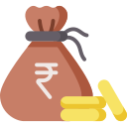




Market Research, Market SWOT & Pain Points
About the company, Features
& Revenue Model
Company SWOT, Competitors &
Competitor Analysis
Go-to Market Strategy & Financials
Appendix I
Appendix II
Target Customer:
People in urban areas with smartphones having a decent internet connection.
Balance Seekers and Priority Jugglers
Market Sentiment: The market is driven by trust. Hence, MedAssist thrives to gain customer’s by winning their trust.
Financials
Cost Head | Expected cost(₹)
App Development | 5,00,000
Maintenance (Per Year) | 1,00,000
Marketing
Digital Marketing | 1,50,000
Influencer marketing | 1,30,000
Press release | 1,00,000
App Store release | 2,00,000
Estimated total cost | 11,80,000
Launch:
Pan India launch of the app on playstore/ios
Mass and Targeted media:
Inbound advertising: TV
Outbound Advertising: Digital, search
Public Relations
Personal and Interpersonal means:
Salesforce, Word Of Mouth, Referrals
Social Media Influencers, Brand Campaigns, Collaboration with brands, giveaway/contest
Revenue model | Pricing(₹) | Conversion rate | Amount(₹)
Plus | 200 | 5% | 5,00,000
Subscription (Yearly) | 500 | 2% | 10,00,000
Comission (per order of Rs 100) | 5 | 2% | 50,000*
Consultation fraction (per meeting of Rs 300) | 30 | 5% | 3,75,000**
Expected Revenue(after 2 years) |  |  | 19,25,000
Promotion Strategy:
TV Promotions at peak viewing hours at multiple channels having larger viewership. Our advertising partners: Star Network, Colors, etc.
Digital, Search: SEO/SEM, Blogs, Pay per Click Advertisements, Content Marketing for maximum appearances, Conversion Rate Optimization(CRO)
Public Relations: Celebrity endorsement
Building brand awareness instantly.
Product or brand easily recallable.
To enhance market value and capitalisation.
Word of Mouth
Non-Communication: Incentives like Medcoins, which could be used for other purposes.
      Increase credibility.
      Spread brand message to attract new users.
      Positioning the brand by influencing consumer decision
*Considering 2% people purchased medicines of Rs 1000 in 2 years
**Considering 5% people had at least 5 consultations in 2 years
***Financials are based on the assumption that our user base is 50000 after 2 years.

Slide 6
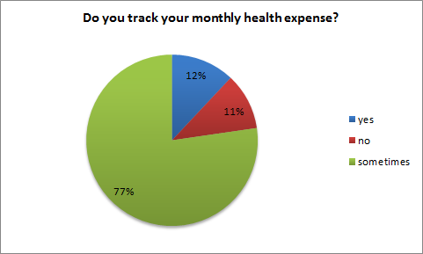
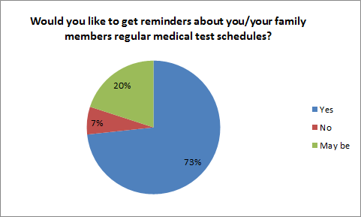
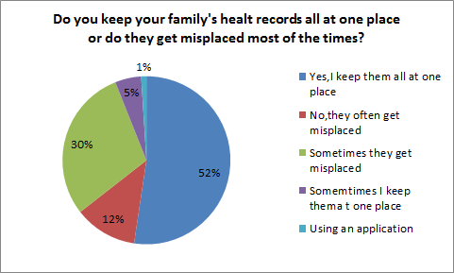
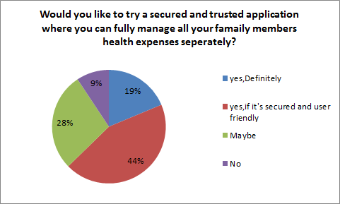
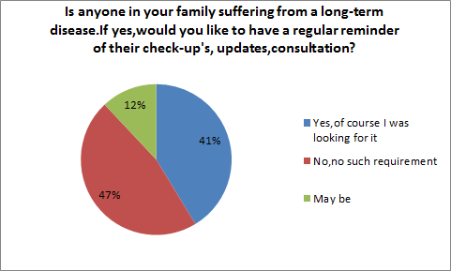
Market Research, Market SWOT & Pain Points
About the company, Features
& Revenue Model
Company SWOT, Competitors &
Competitor Analysis
Go-to Market Strategy & Financials
Appendix I
Appendix II
Exhibit 1
Exhibit 3
Exhibit 5
Exhibit 2
Exhibit 4
Audience Profile –
200+ survey responses
15+ telephonic interviews
Age – 21-45
65% Male 35% Female
62% Urban, 38% semiurban
39% Housewives, 31% working professionals, 25% students, 5% others

Slide 7
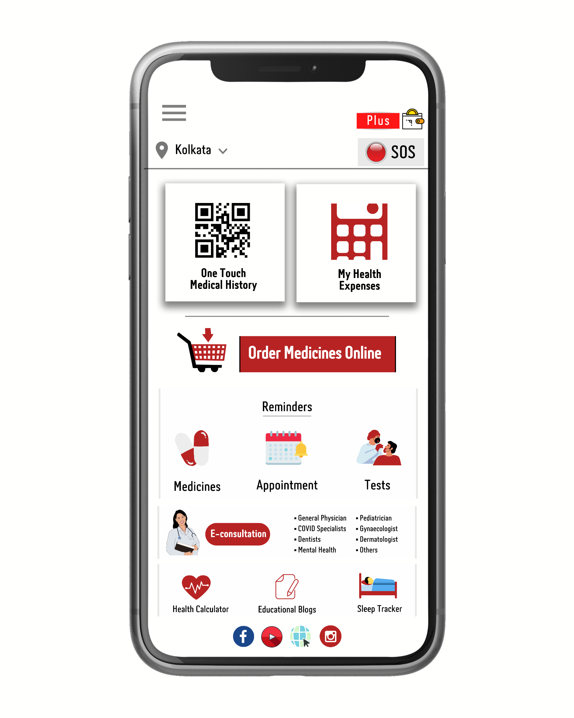
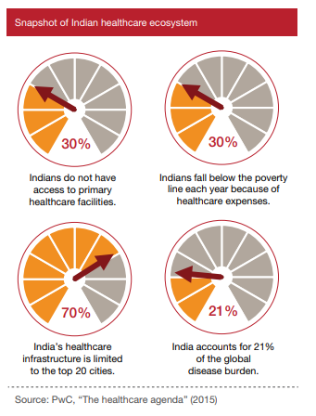
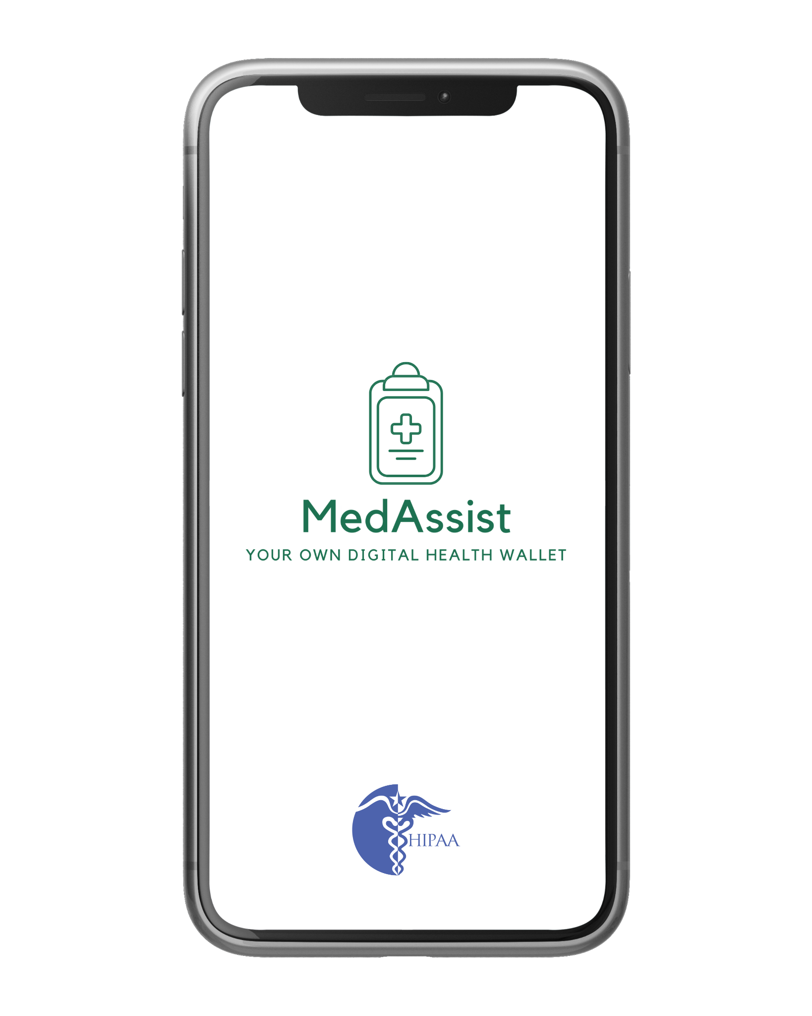
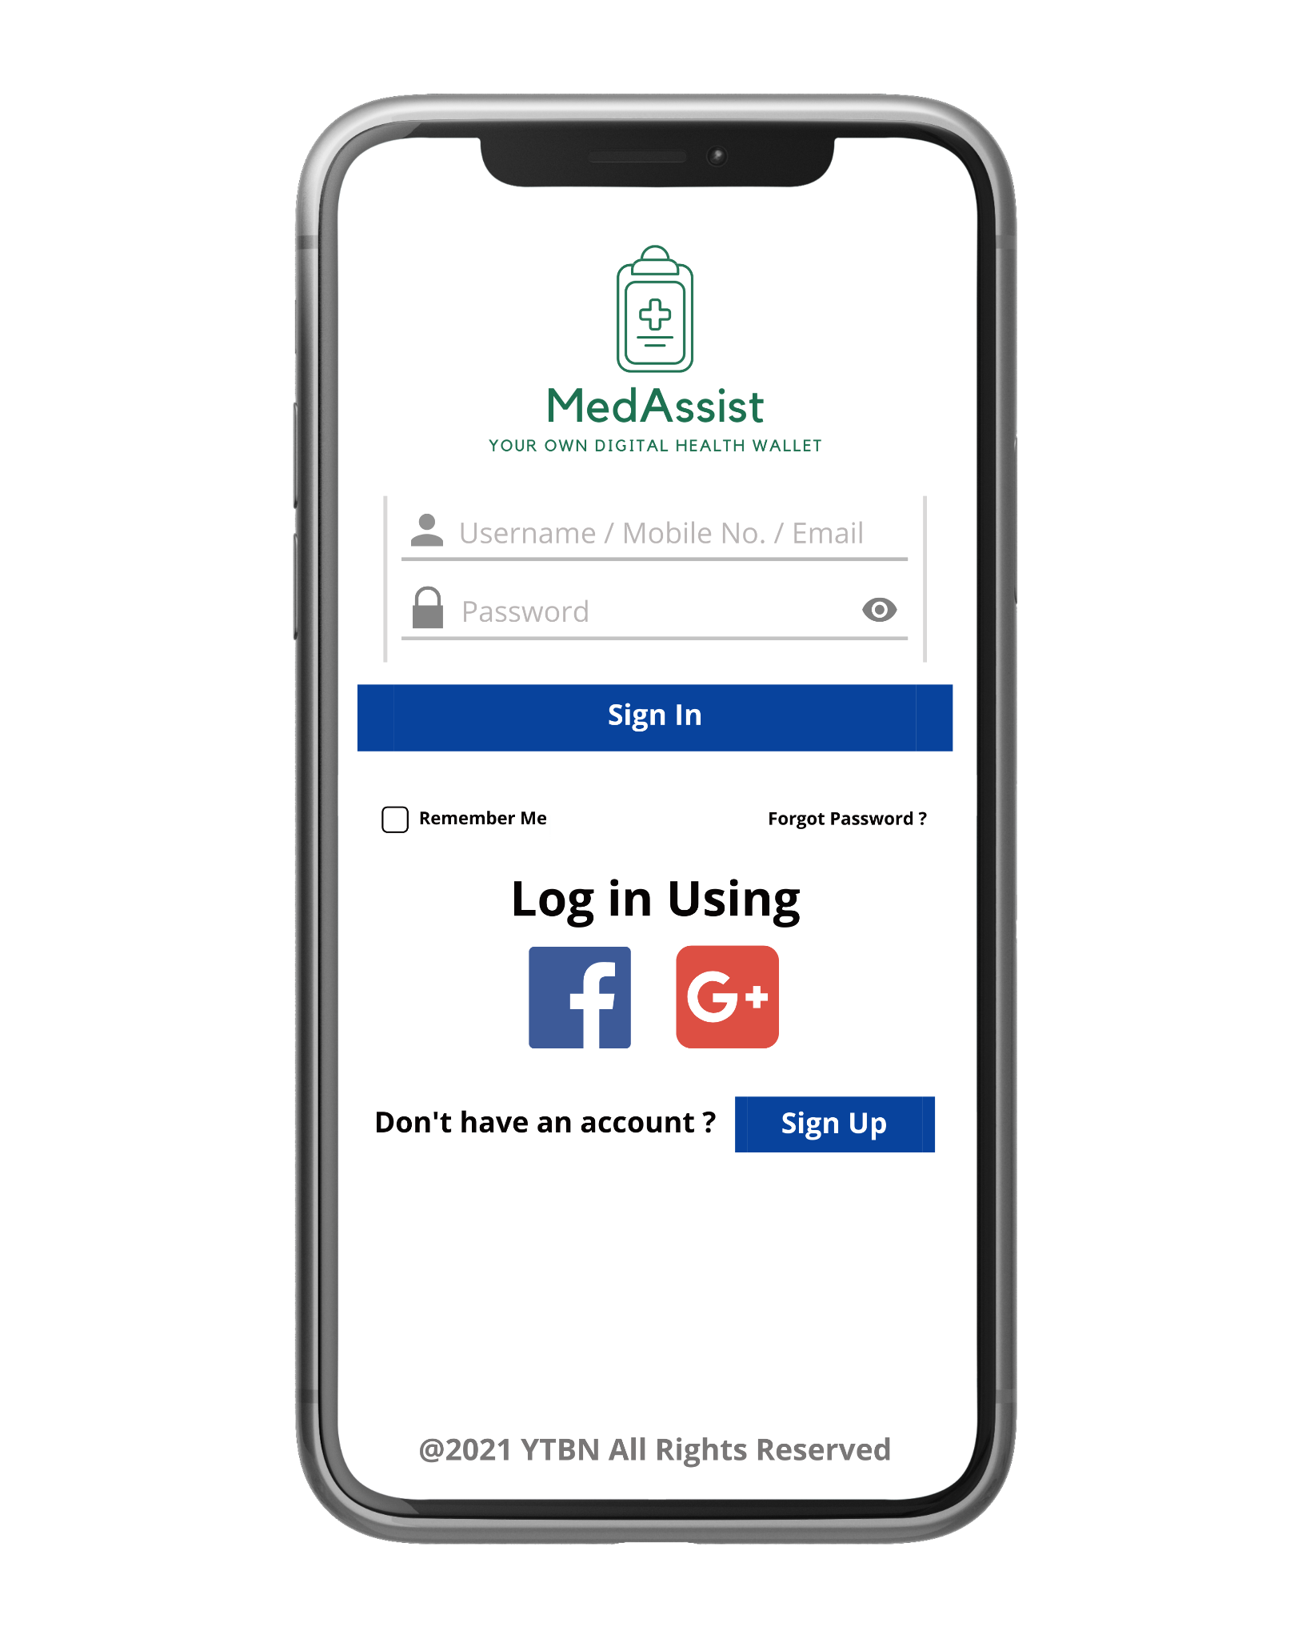
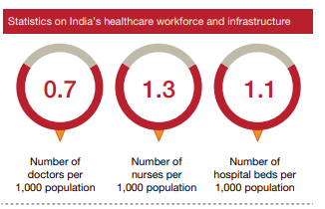
Market Research, Market SWOT & Pain Points
About the company, Features
& Revenue Model
Company SWOT, Competitors &
Competitor Analysis
Go-to Market Strategy & Financials
Appendix I
Appendix II
Exhibit 6
Exhibit 8
Exhibit 7

